Slide 1
pandas.DataFrame module 4
Note to other teachers and users of these slides. Feel free to use or modify these slides as you wish. If you use a significant portion of these slides in your own lecture, please include this message, or the following link to the source repository of Michele’s lectures on github:
https://github.com/samorani. Comments and corrections are welcome.

Slide 2
DataFrame

Slide 3
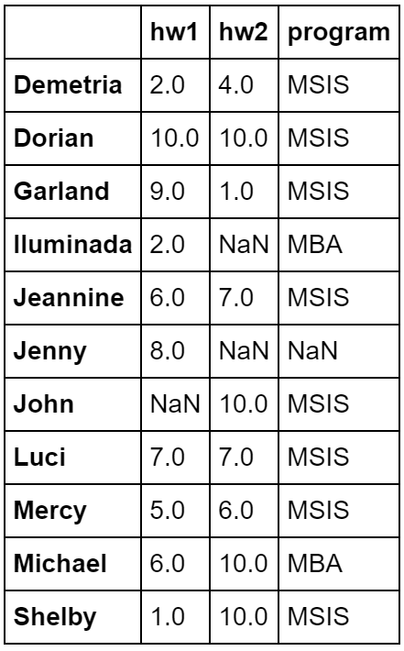
DataFrame = Table
POSITIONAL INDEX
ON THE COLUMNS
INDEX
0 1 2
0
1
2
3
4
5
6
7
8
9
10
COLUMNS
(It’s an Index object)
VALUES
POSITIONAL INDEX
ON THE ROWS

Slide 4
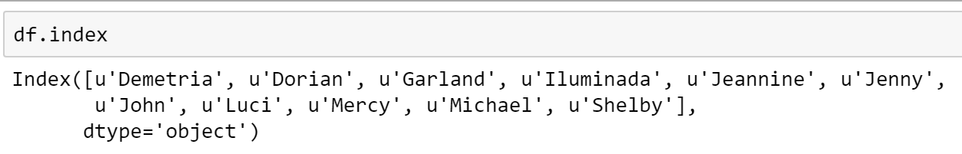
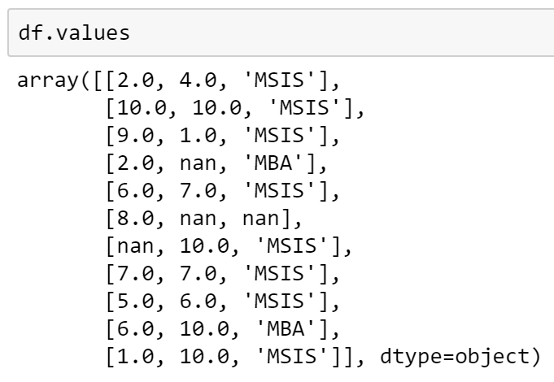
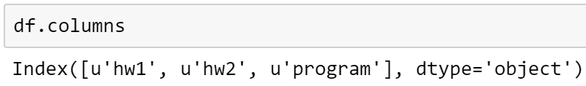
Index, columns, values
POSITIONAL INDEX
ON THE COLUMNS
Return the index (as an index object), the columns (as index object) and the values (as 2-dimensional ndarray)
Example:
0 1 2
INDEX
COLUMNS
0
1
2
3
4
5
6
7
8
9
10
POS. INDEX
ON ROWS
VALUES

Slide 5
df.iloc[x,y]
POSITIONAL INDEX
ON THE COLUMNS
Access using the positional index..
x is the information needed to select the rows: positional index or range of integers
y (optional) is the information needed to select the columns: positional index or range of integers
0 1 2
INDEX
COLUMNS
0
1
2
3
4
5
6
7
8
9
10
POS. INDEX
ON ROWS
VALUES

Slide 6


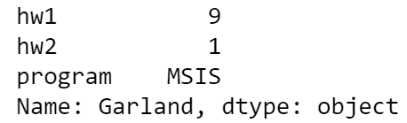
df.iloc[x,y] – one row
POSITIONAL INDEX
ON THE COLUMNS
0 1 2
INDEX
COLUMNS
0
1
2
3
4
5
6
7
8
9
10
POS. INDEX
ON ROWS
RESULT:
A Series!

Slide 7

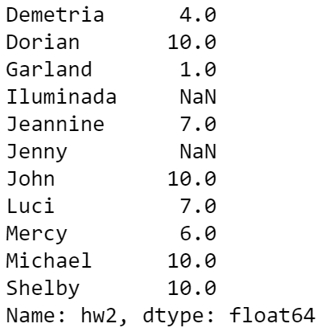
df.iloc[x,y] – one column
POSITIONAL INDEX
ON THE COLUMNS
0 1 2
INDEX
COLUMNS
RESULT:
0
1
2
3
4
5
6
7
8
9
10
POS. INDEX
ON ROWS

Slide 8

df.iloc[x,y] – one specific value
POSITIONAL INDEX
ON THE COLUMNS
0 1 2
INDEX
COLUMNS
0
1
2
3
4
5
6
7
8
9
10
POS. INDEX
ON ROWS

Slide 9

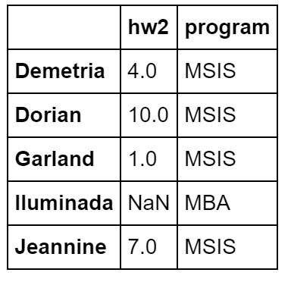
df.iloc[x,y] – a subset of rows/columns
POSITIONAL INDEX
ON THE COLUMNS
0 1 2
INDEX
COLUMNS
0
1
2
3
4
5
6
7
8
9
10
POS. INDEX
ON ROWS

Slide 10
df.loc[x,y]
POSITIONAL INDEX
ON THE COLUMNS
Access using the index labels.
x s the information needed to select the rows: label index, range of index labels, or boolean masks
y (optional) is the information needed to select the columns: label index, range of index labels, or boolean masks
0 1 2
INDEX
COLUMNS
0
1
2
3
4
5
6
7
8
9
10
POS. INDEX
ON ROWS
VALUES

Slide 11
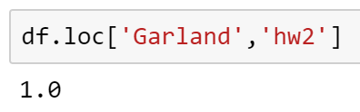
df.loc[x,y] – one specific value
POSITIONAL INDEX
ON THE COLUMNS
0 1 2
INDEX
COLUMNS
0
1
2
3
4
5
6
7
8
9
10
POS. INDEX
ON ROWS

Slide 12


df.loc[x,y] – one row
POSITIONAL INDEX
ON THE COLUMNS
0 1 2
INDEX
COLUMNS
0
1
2
3
4
5
6
7
8
9
10
POS. INDEX
ON ROWS
RESULT:
A Series!

Slide 13


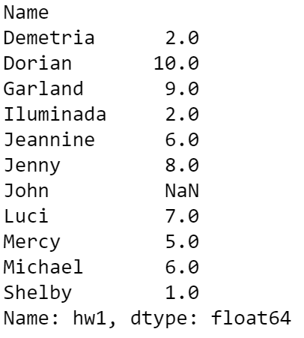

df.loc[x,y] – one column
POSITIONAL INDEX
ON THE COLUMNS
0 1 2
INDEX
COLUMNS
0
1
2
3
4
5
6
7
8
9
10
RESULT:
POS. INDEX
ON ROWS
COOL NOTATION

Slide 14

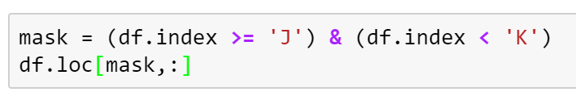
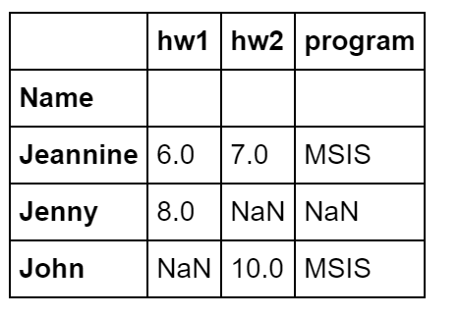
df.loc[x,y] – using Boolean masks
POSITIONAL INDEX
ON THE COLUMNS
0 1 2
INDEX
COLUMNS
0
1
2
3
4
5
6
7
8
9
10
POS. INDEX
ON ROWS

Slide 15
Problems
Retrieve Shelby's hw1 grade
Retrieve Shelby's information
Who obtained the highest grade in hw2? Note that there are ties
Find those students who obtained the same score in hw1 and in hw2.
Find the average hw1 score of those students who got a hw2 score greater than 5.

Slide 16
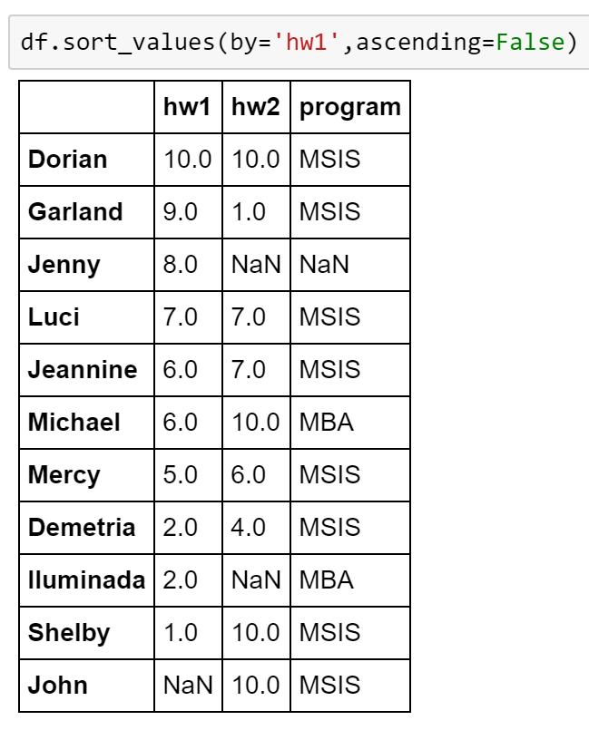
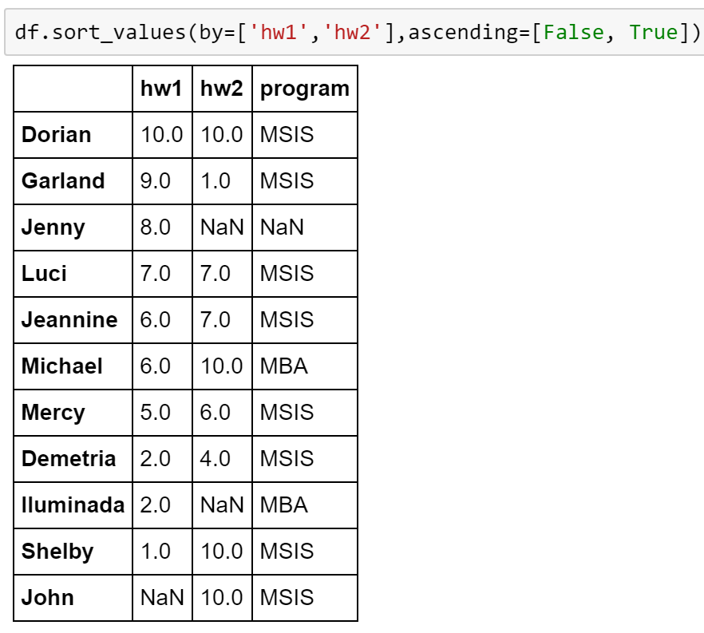
sort_values
Sort the rows based on the value of a column
POSITIONAL INDEX
ON THE COLUMNS
0 1 2
INDEX
COLUMNS
0
1
2
3
4
5
6
7
8
9
10
POS. INDEX
ON ROWS

Slide 17
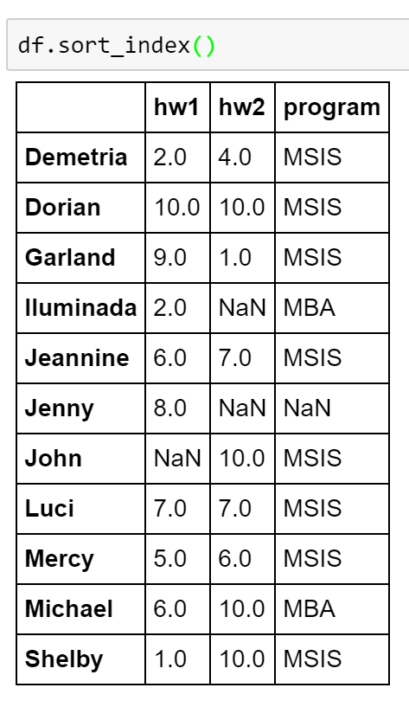
sort_index
Sort by the index labels
POSITIONAL INDEX
ON THE COLUMNS
0 1 2
INDEX
COLUMNS
0
1
2
3
4
5
6
7
8
9
10
POS. INDEX
ON ROWS

Slide 18
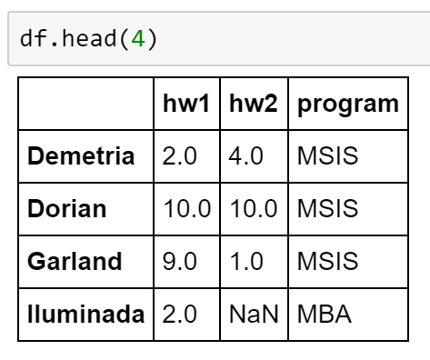
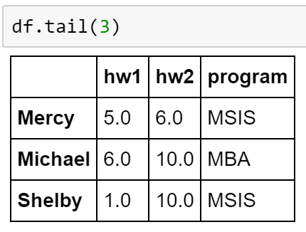
head and tail
POSITIONAL INDEX
ON THE COLUMNS
Return the first or last rows
0 1 2
INDEX
COLUMNS
0
1
2
3
4
5
6
7
8
9
10
POS. INDEX
ON ROWS

Slide 19
Problems
Sort the MSIS students by hw2 descending.
Show only the field hw1 of the four students with the largest hw2 grade (do not use nlargest on the dataframe... it has bugs)

Slide 20
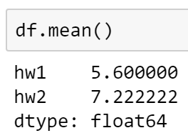
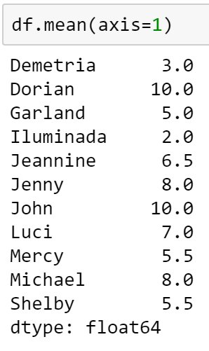
mean, max, min, etc
Aggregate functions will be broadcasted to all columns (axis = 0, default) or rows
POSITIONAL INDEX
ON THE COLUMNS
0 1 2
INDEX
COLUMNS
0
1
2
3
4
5
6
7
8
9
10
POS. INDEX
ON ROWS

Slide 21
Problems
Compute the spread (i.e., highest minus lowest hw grade) of each student. Consider only the students who submitted both homeworks
Who has the largest spread?

Slide 22
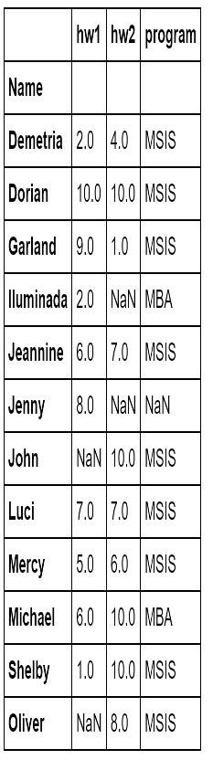
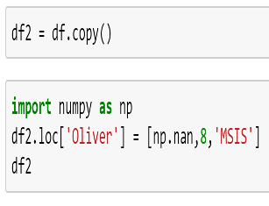
Adding rows
POSITIONAL INDEX
ON THE COLUMNS
A new student has joined. His name is Oliver and he is the MSIS program; his hw1 is missing and his hw2 score is 8.
0 1 2
COLUMNS
INDEX
0
1
2
3
4
5
6
7
8
9
10
11
POS. INDEX
ON ROWS

Slide 23
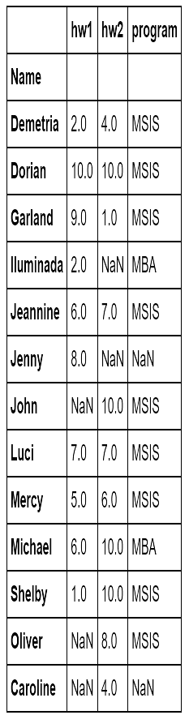
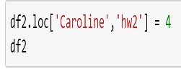
Adding rows
POSITIONAL INDEX
ON THE COLUMNS
A new student has joined. Her name is Caroline and she got 4 in hw2. She is not in any program yet.
0 1 2
COLUMNS
INDEX
0
1
2
3
4
5
6
7
8
9
10
11
12
POS. INDEX
ON ROWS

Slide 24
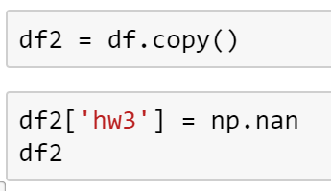
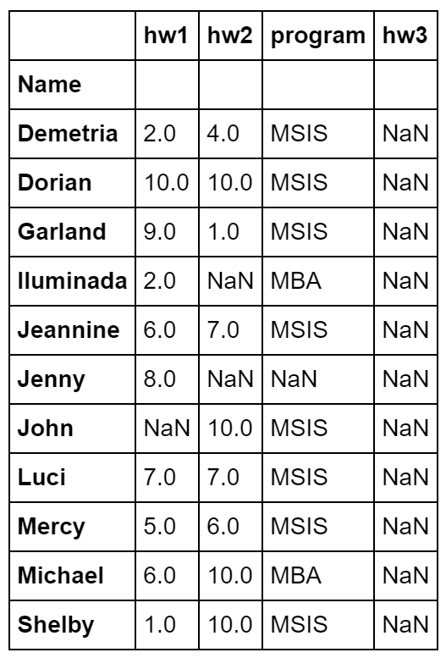
Adding columns
POSITIONAL INDEX
ON THE COLUMNS
Add an "empty" column hw3
0 1 2
COLUMNS
INDEX
0
1
2
3
4
5
6
7
8
9
10
POS. INDEX
ON ROWS

Slide 25
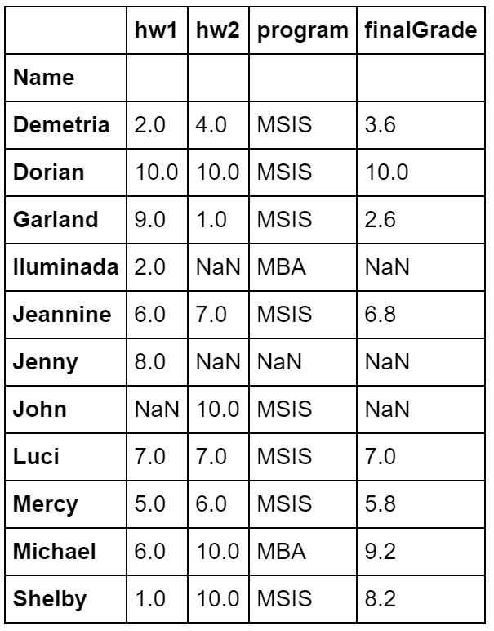
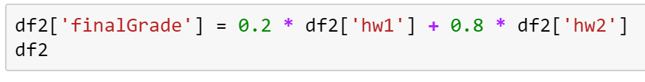
Adding calculated columns
POSITIONAL INDEX
ON THE COLUMNS
Let's add a column with the final grade. It is computed as 0.2*hw1 + 0.8*hw2.
0 1 2
COLUMNS
INDEX
0
1
2
3
4
5
6
7
8
9
10
POS. INDEX
ON ROWS

